Slide 1

Köppen Climate Classification
By
MOHD ARIF

Slide 2

INTRODUCTION
The Köppen climate classification is one of the most widely used climate classification .
It was first published by Russian German climatologist Wladimir Köppen in 1884, with several later modifications by Köppen himself, notably in 1918 and 1936.
Later, German climatologist Rudolf Geiger collaborated with Köppen on changes to the classification system, which is thus sometimes referred to as the Köppen–Geiger climate classification system.

Slide 3
The system is based on the concept that:
Native vegetation is the best expression of climate. The Köppen system recognizes five major climatic types; each type is designated by a capital letter Its categories are based on the annual and monthly averages of temperature and precipitation.

Slide 4

BASIS OF CLASSIFICATION
Koppen presented his climatic classification on the basis of candolle’s classification of vegetation which recognise the following divisions:
Megatherms
Those plant which depend on high temperature and humidity through out the year and avg. temp above 18 degree celsius.
tropical rain forest.
Xerophytic:
represent such plant which thrive in hot and arid condition.
Mesothermal:
represent such plant that are adapted to moderate temperature and abundant supply of moisture.
The temp. of the coldest month below 18 but above -3 degree c.
mid latitude temperate region.
Microthermal:
region having temp. of coldest month below -3 .
cool temperate region.
Hekistothermal:
permanently ice covered region.

Slide 5

Scheme
Koppen divided world climate on five principle types and designated them as capital letters
A B C D E | Tropical Moist Climates: all months have average temperatures above 18 degrees Celsius Dry Climates: with deficient precipitation during most of the year Moist Mid-latitude Climates with Mild Winters Moist Mid-Latitude Climates with Cold Winters Polar Climates: with extremely cold winters and summers

Slide 6

Besides capital letters he used various small letters in his climatic scheme
f | Precipitation through out year
m | Monsoon climate short dry season
w | Dry season in winter
s | Dry season in summer
h | Mean annual temperature above 18 degree c
k | Mean annual temperature below 18 degree c
a | Hot summer temp of warmest month above 22 degree c
b | Cold winter temperature of warmest month below 22 degree c
c | Cool short summer with less than four month over 10 degree c

Slide 7
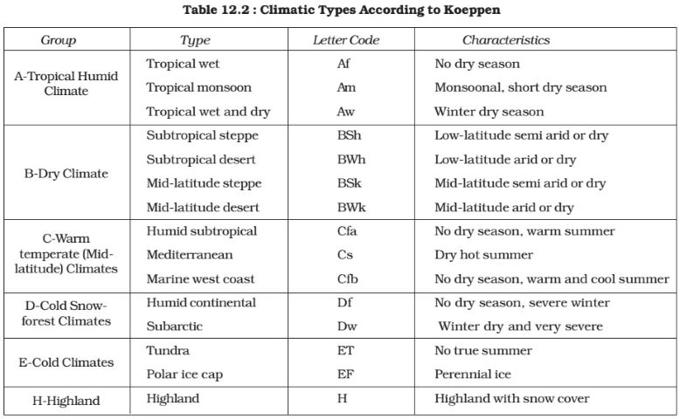
CLIMATIC CLASSIFICATION GIVEN BY KOPPEN

Slide 8
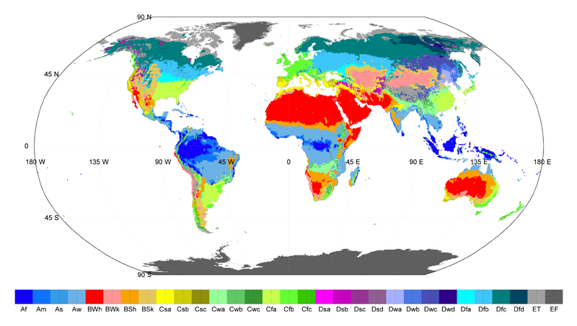
WORLD CLIMATIC TYPES BASED ON CLIMATIC CLASSIFICATION GIVEN BY KOPPEN

Slide 9
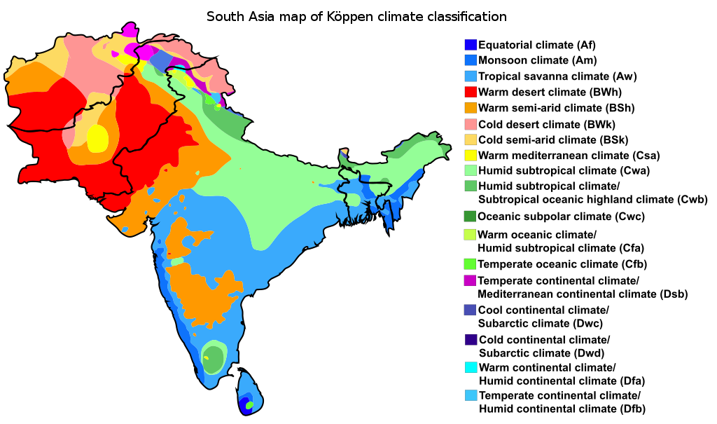

Slide 10
THANKS

